Slide 1



2025 2nd Asia Pacific Conference on Innovation in Technology (APCIT)
Optic Disc and Cup Segmentation Using Deep CNN Ensembles for Glaucoma Staging
Paper ID: 1997
D.Mounika
Narasaraopeta Engineering College (Autonomous)

Slide 2

Contents
Abstract
Introduction
Problem Statement
Research Objectives
Literature Review
Proposed System
Methodology
Output Screen
Conclusion

Slide 3
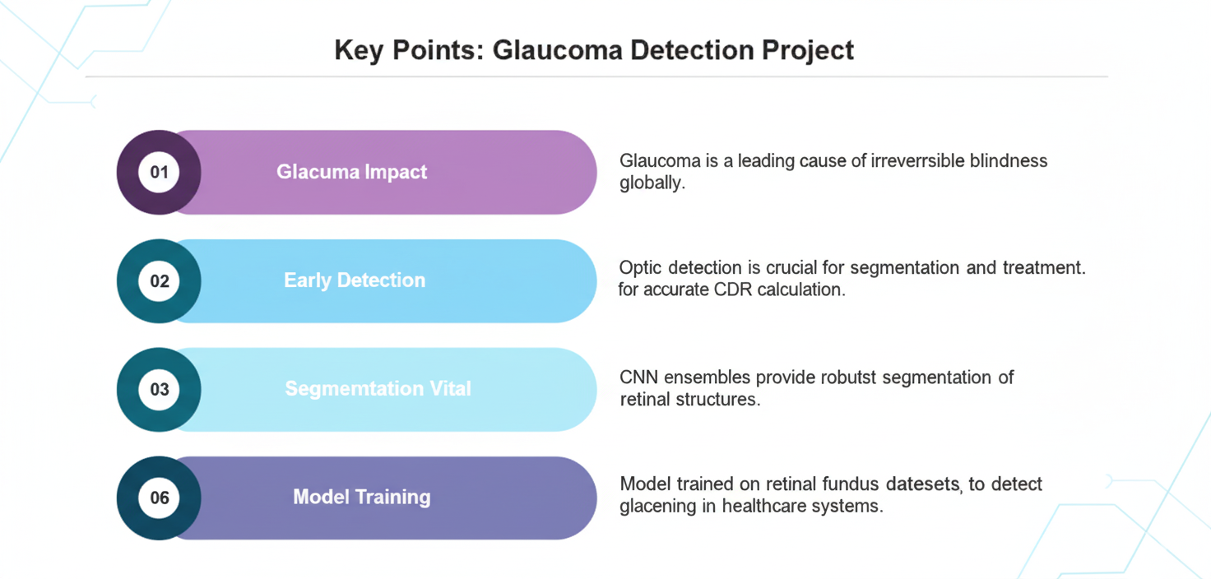
Abstract

Slide 4

Introduction
Glaucoma progressively damages the optic nerve, leading to blindness.
Screening involves evaluating the optic disc and cup in retinal images.
Manual screening is time-consuming and subjective.
Automated systems enhance early detection and clinical workflows.
CNNs excel in extracting features from complex medical images.
Ensemble methods improve accuracy and robustness in segmentation.

Slide 5
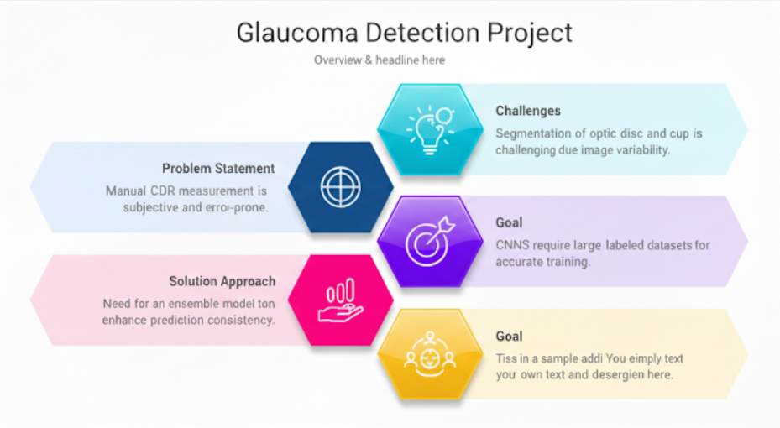
Problem Statement

Slide 6
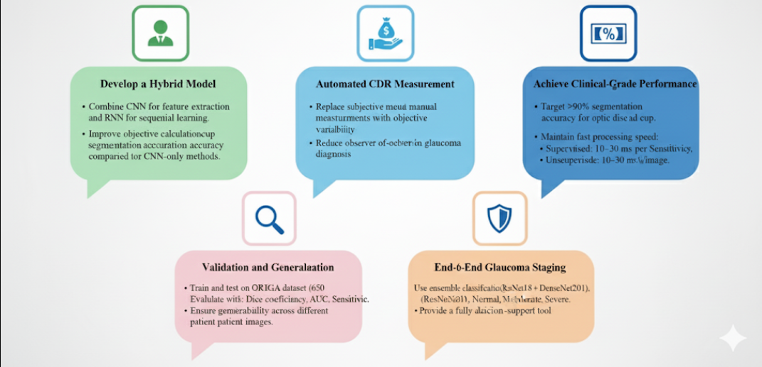
Research Objectives

Slide 7
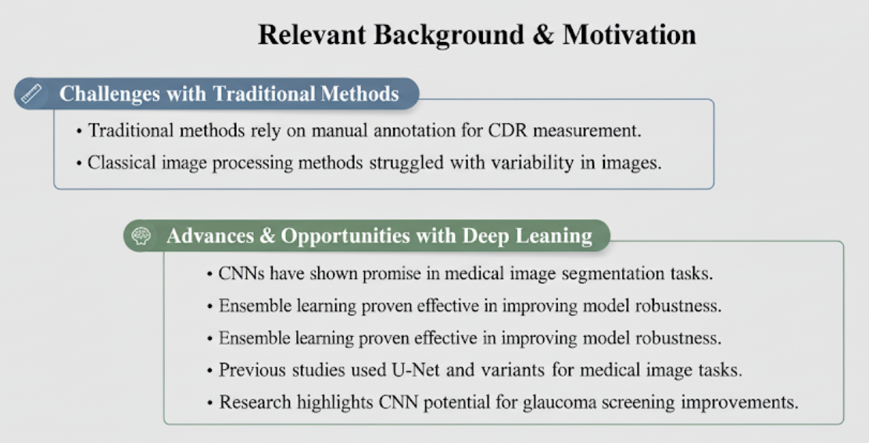
Literature Review
Manual annotation needed for CDR measurement.
Classical methods struggled with image variability.
CNNs promising for medical image segmentation.
Ensemble learning improves model robustness.
U-Net & variants widely used in medical imaging.
CNN shows strong potential for glaucoma screening.

Slide 8
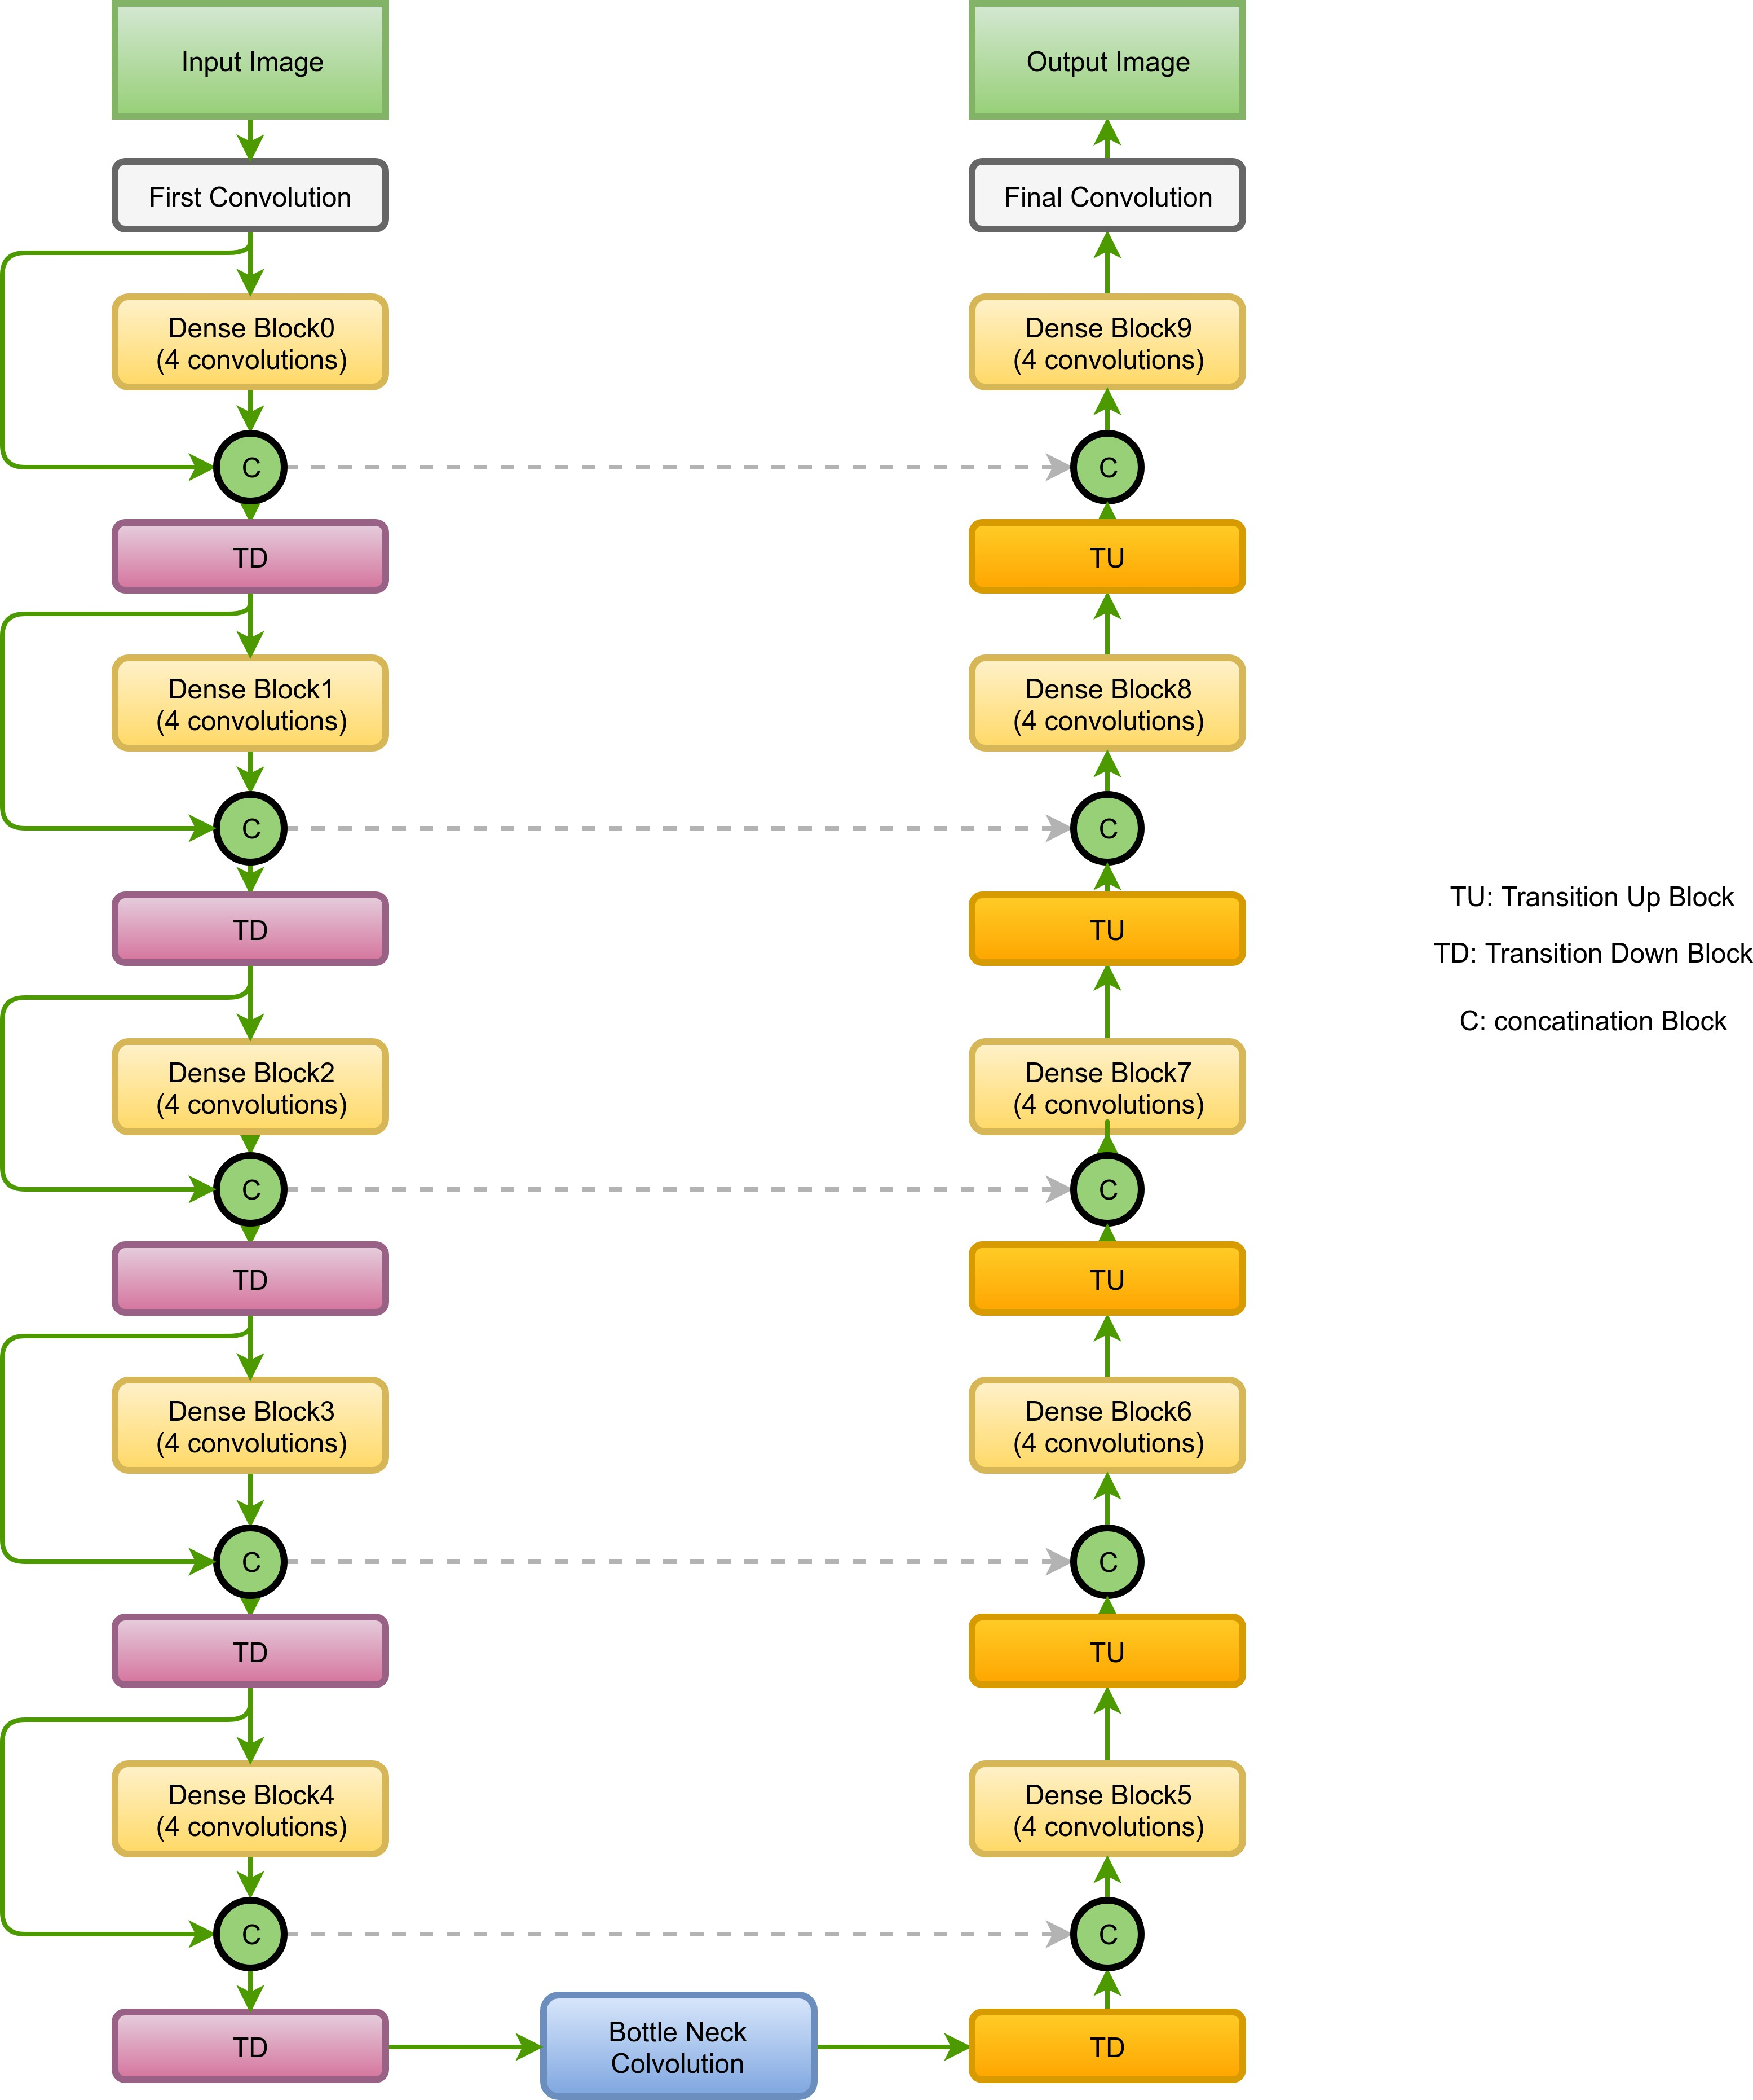
Proposed System
Input & Output: Fundus image → Segmentation mask (optic disc & cup).
Encoder Path: Dense Blocks (0–4, 4 convs each), Transition Down (TD) for down-sampling, feature compression.
Bottleneck: Bottle Neck Convolution connects encoder & decoder, captures global context.
Decoder Path: Dense Blocks (5–9), Transition Up (TU) for up-sampling, Skip Connections (C) for boundary precision.
Final Convolution: Generates optic disc & cup segmentation mask.

Slide 9
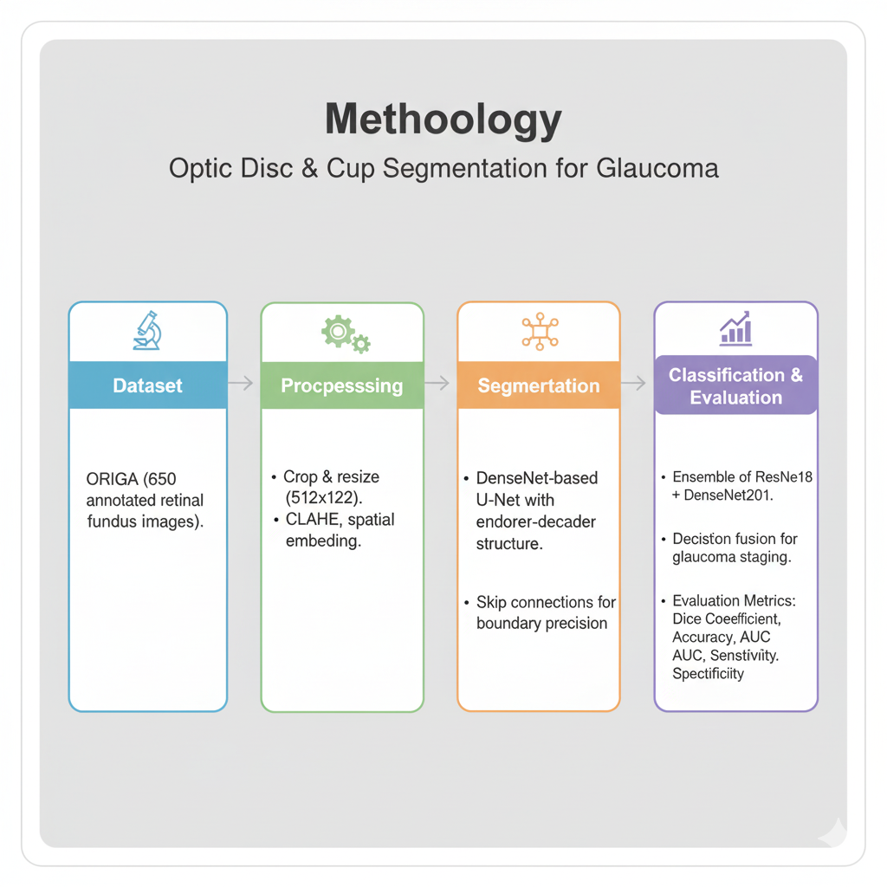
Methodology
Dataset: ORIGA (650 annotated retinal fundus images).
Preprocessing:
Crop & resize (512×512).
CLAHE, spatial embedding.
Segmentation:
DenseNet-based U-Net with encoder–decoder structure.
Skip connections for boundary precision.
Classification:
Ensemble of ResNet18 + DenseNet201.
Decision fusion for glaucoma staging.
Evaluation Metrics: Dice Coefficient, Accuracy, AUC, Sensitivity, Specificity.

Slide 10
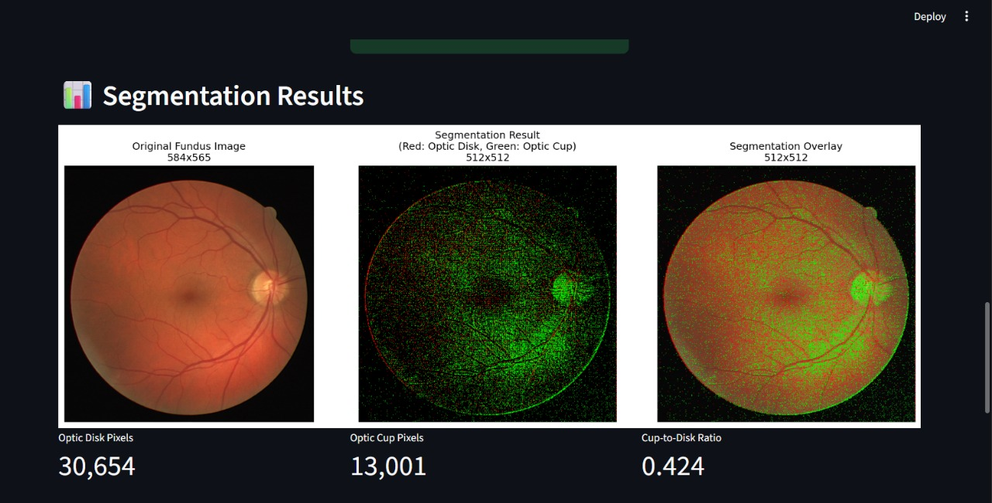
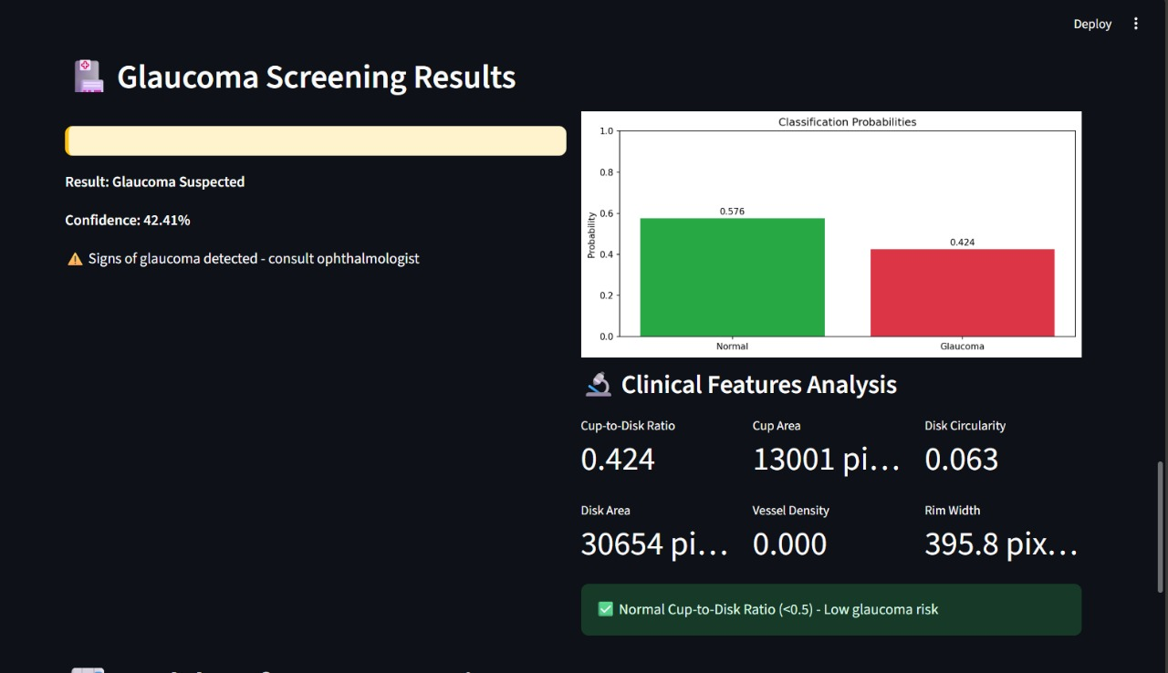
Output Screen :

Slide 11
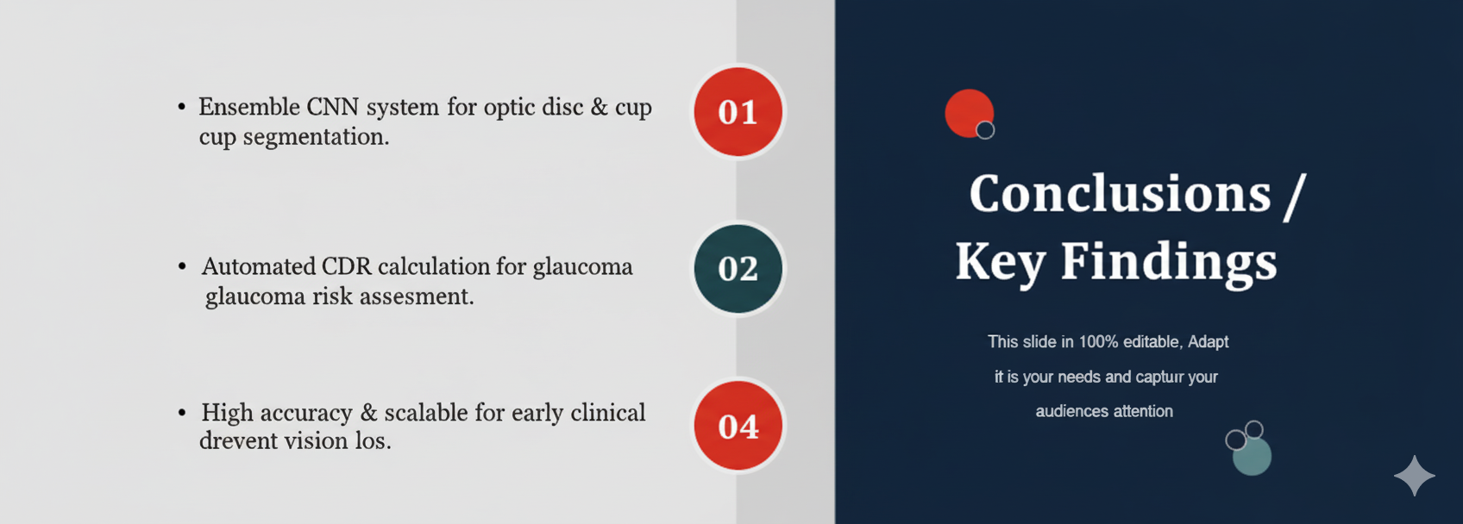
Conclusion

